Slide 1
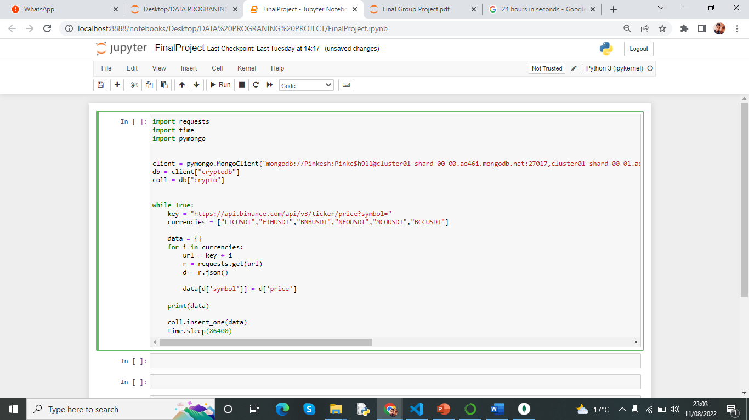
Run every 24 hours and get data

Slide 2
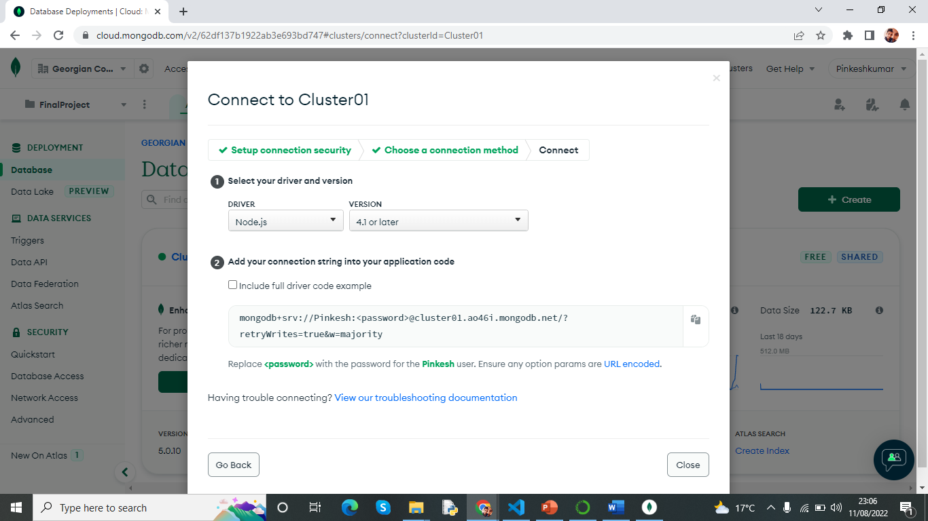
Use this link to connect our application to database

Slide 3
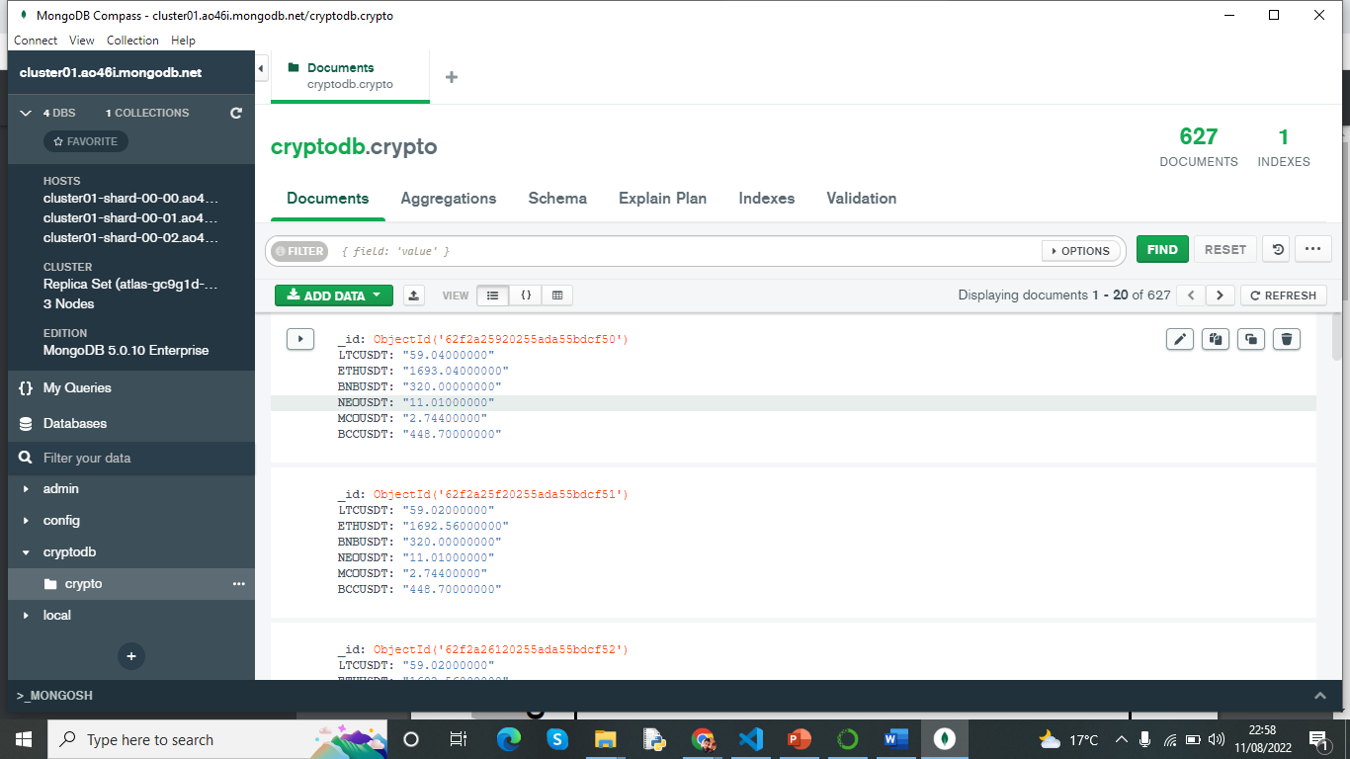
Used mongod DB compass to see the data

Slide 4
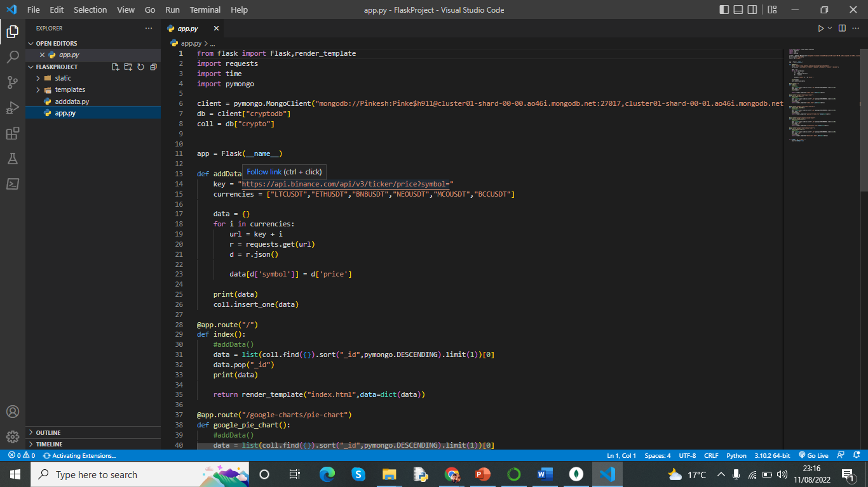

Slide 5
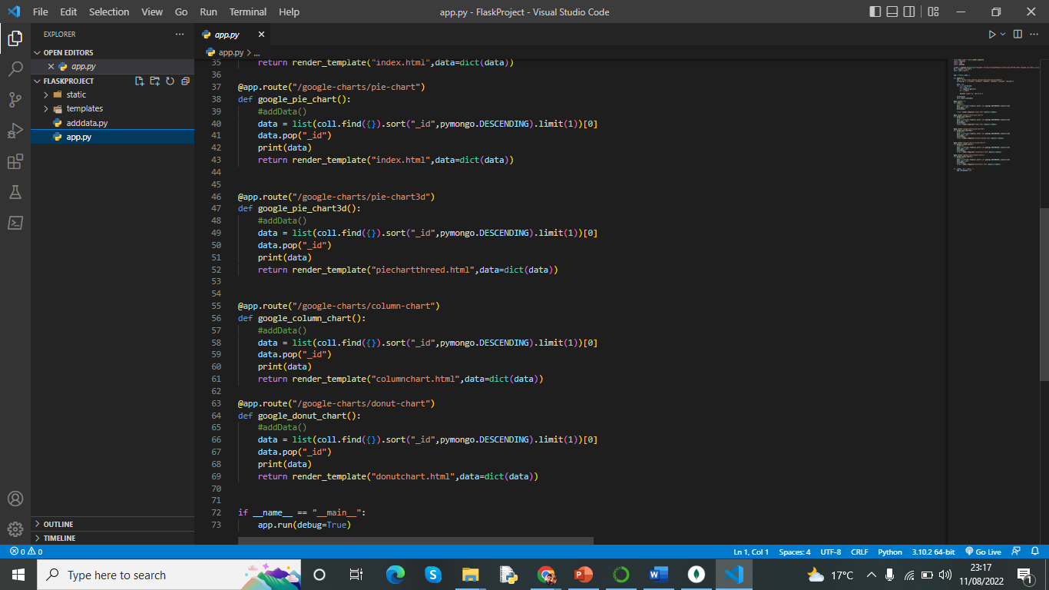

Slide 6
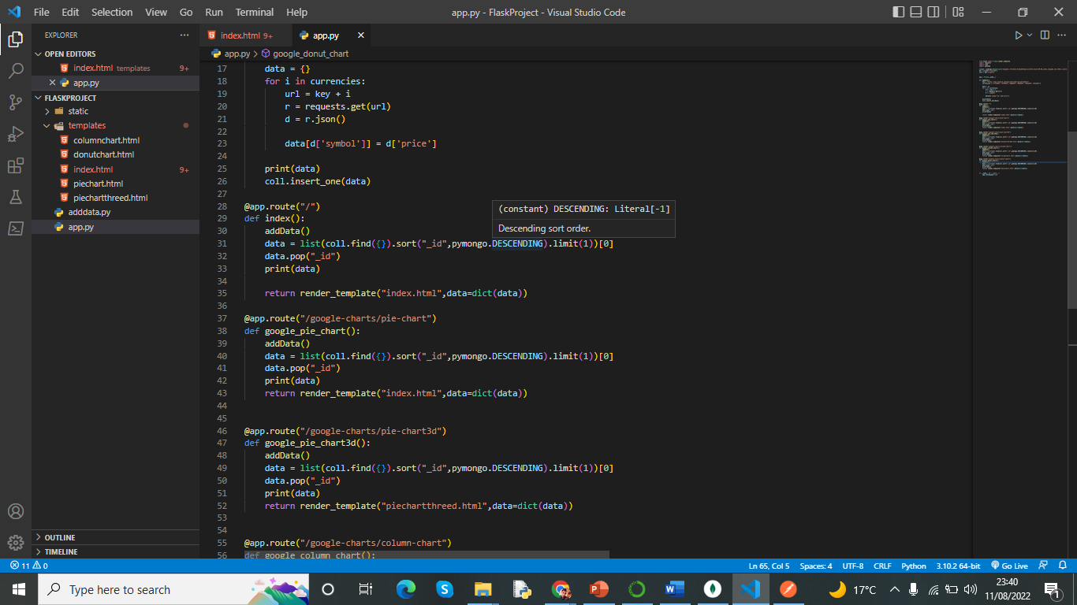
In addition, The addData() function we have marked which is used when we have to change data in when we change the chart type in web app and store that data in to mongo DB. When we comment this line addData() it stop taking data in each click.

Slide 7
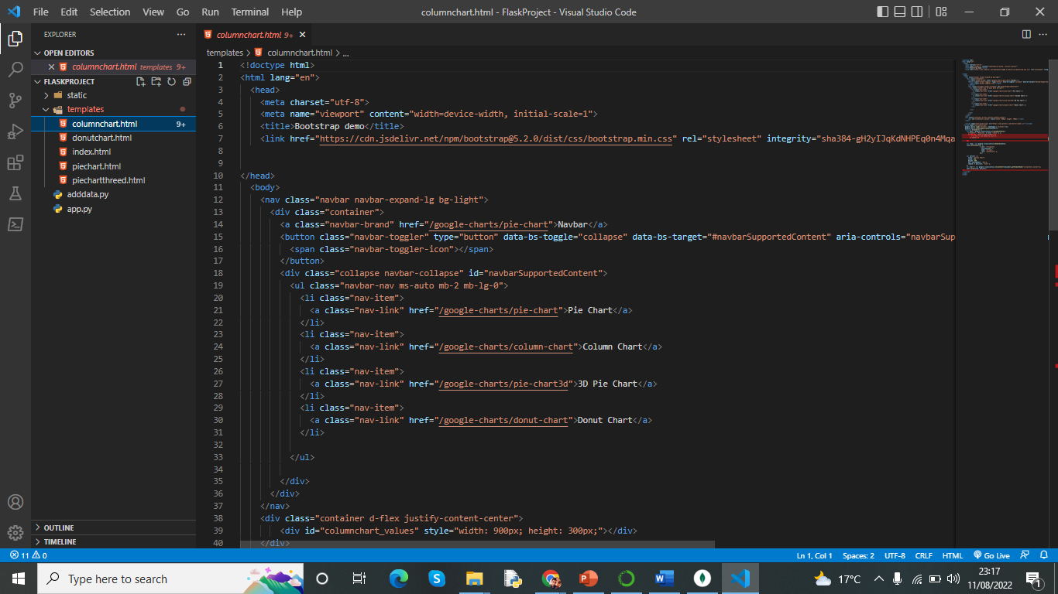
Code for column chart

Slide 8
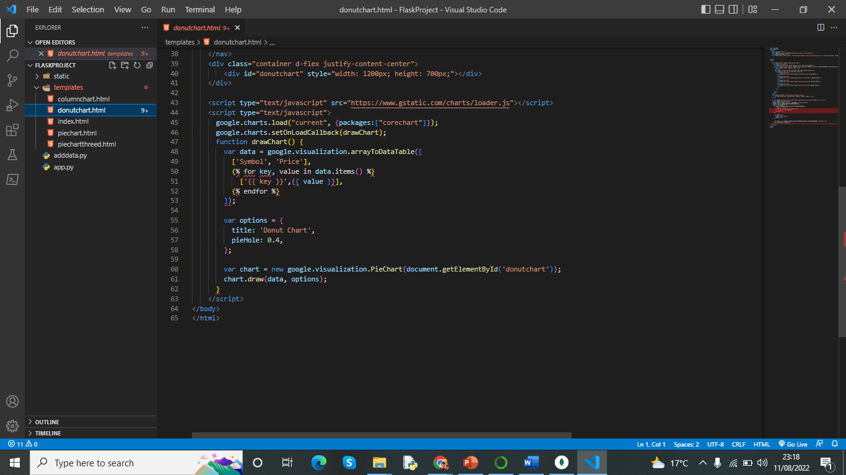
Quick look of donut chart

Slide 9
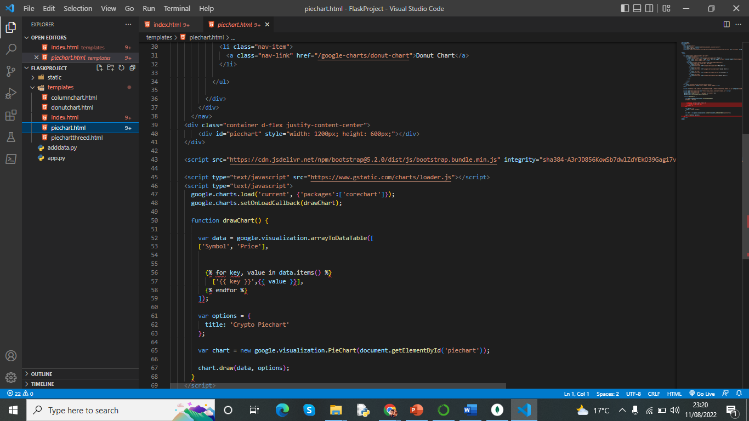
Piechart code

Slide 10
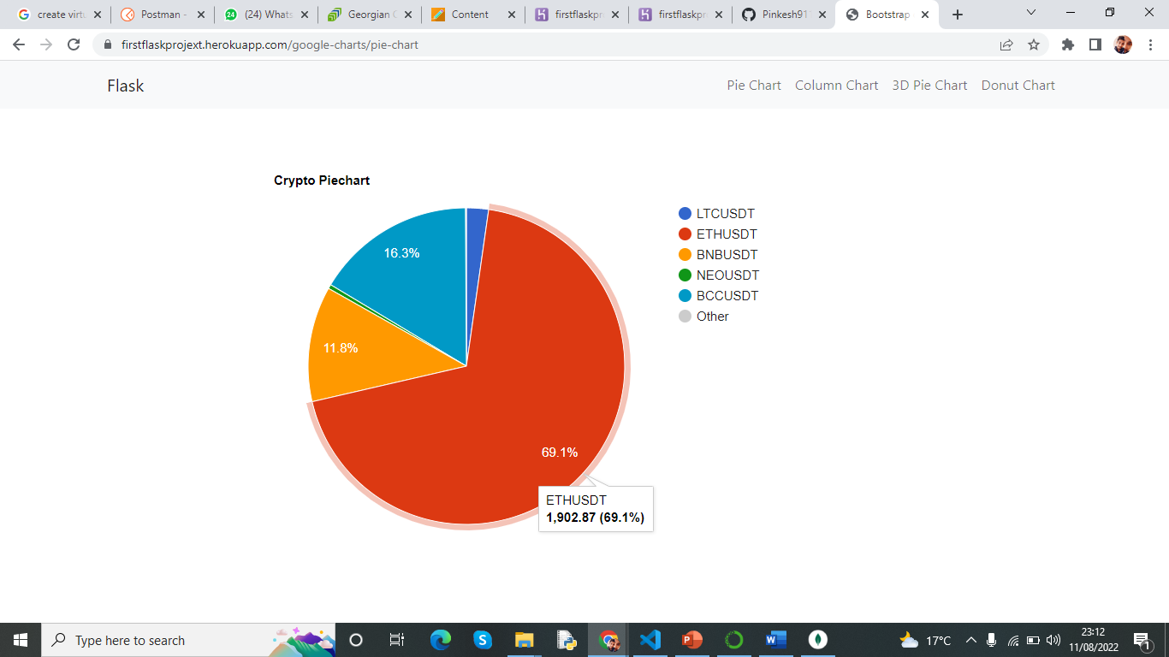

Slide 11
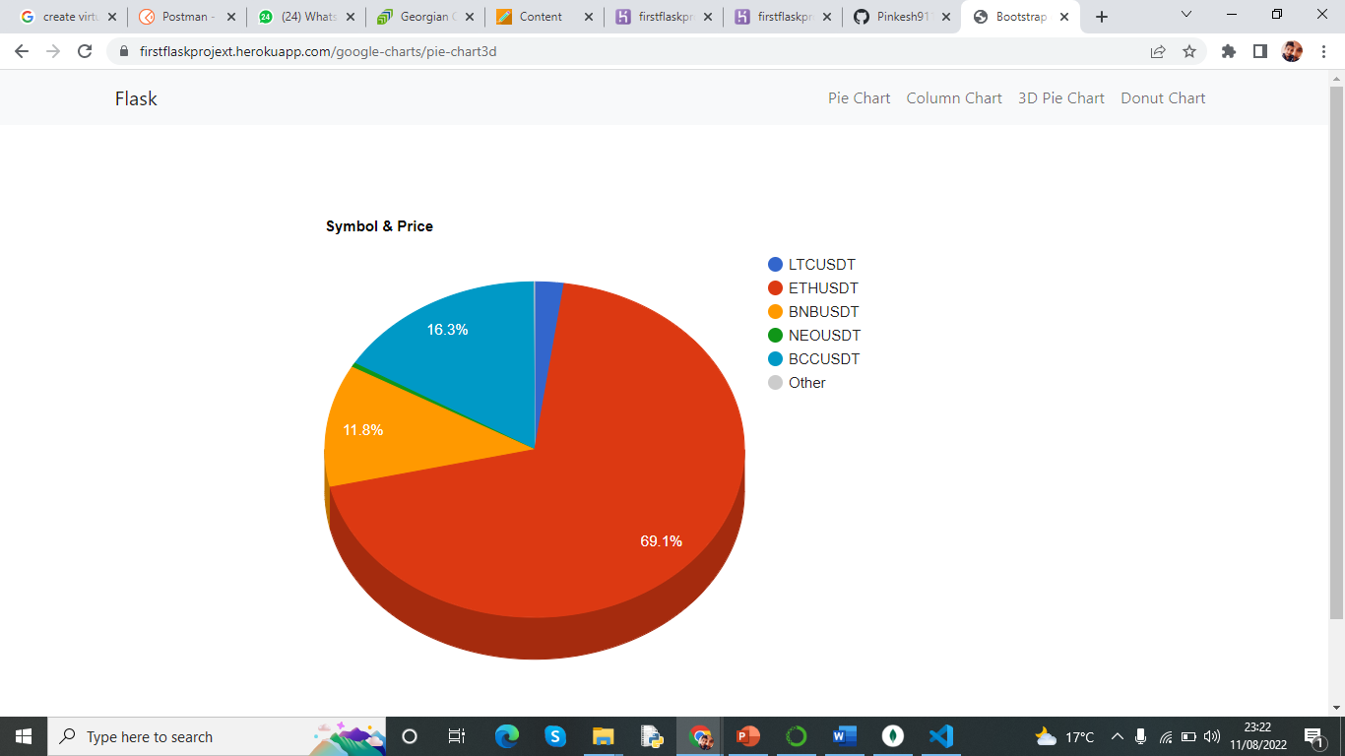

Slide 12
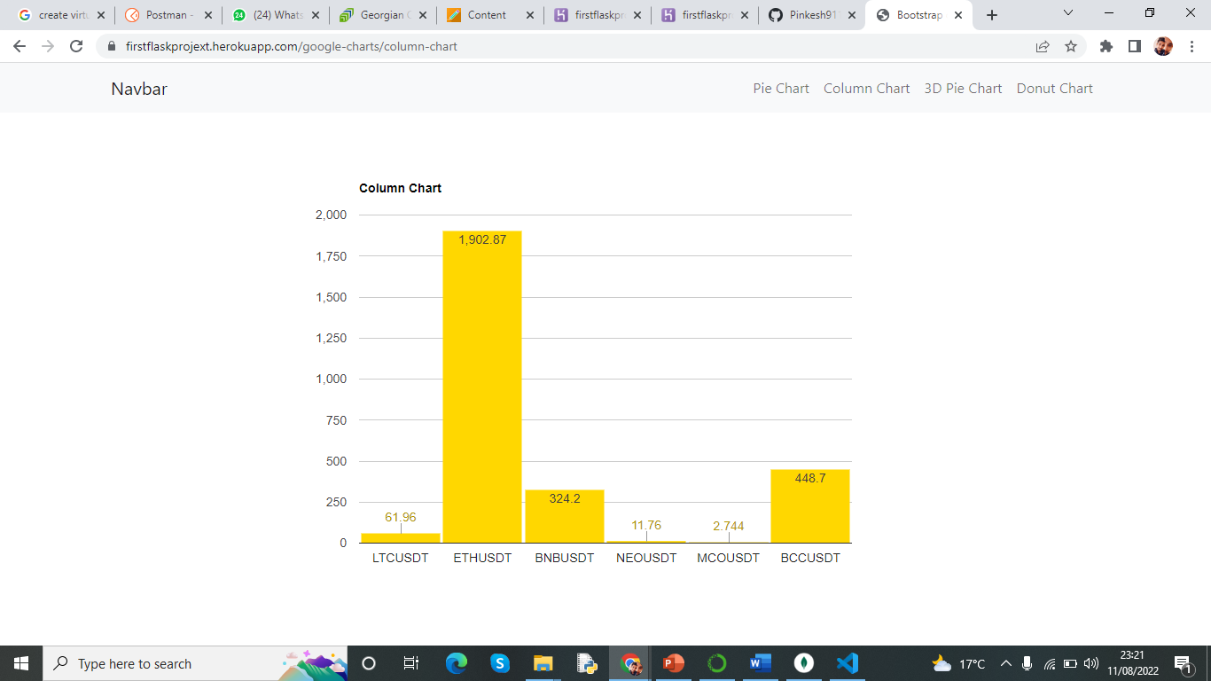

Slide 13
